Slide 1
12-LEAD ECG ABNORMALITY IDENTIFICATION
USING ML/DL
ScaleMind - Nguyen Phuong Linh, Hoang Minh Thao

Slide 2
THE IDEA
Develop algorithms to identify 8 rhythm/morphology abnormalities from 12-lead ECGs
(1) Atrial fibrillation (AF)
(2) First-degree atrioventricular block (I-AVB)
(3) Left bundle brunch block (LBBB)
(4) Right bundle brunch block (RBBB)
(5) Premature atrial contraction (PAC)
(6) Premature ventricular contraction (PVC)
(7) ST-segment depression (STD)
(8) ST-segment elevated (STE)

Slide 3
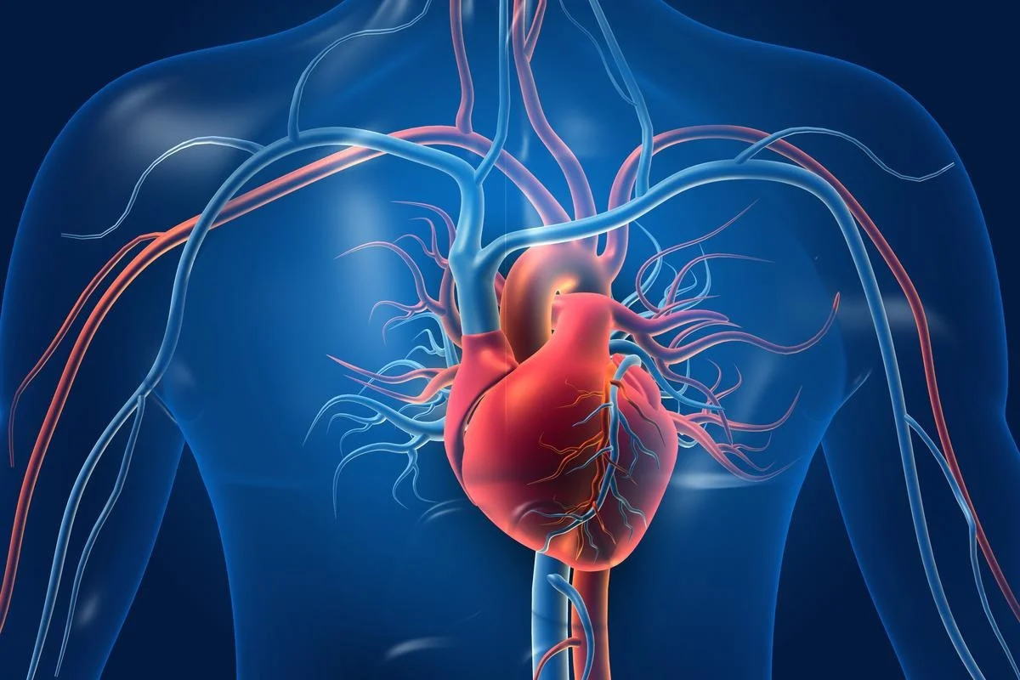
PROBLEM STATEMENT
Some world statistics
17.9 million people die each year from cardiovascular disease
Atrial fibrillation (AF) is the most common of arrhythmia
Early and accurate diagnosis of ECG abnormalities can prevent serious complications

Slide 4
PROBLEM STATEMENT
Pros and cons of medical system
New techniques and advanced machines
Experience doctors
Expensive healthcare cost
Hospital overload
-> waste time
=> Need an automatic diagnosis system: ML/DL

Slide 5
MOTIVATION
Compassion for cardiovascular patients
Benefits of ML/DL
Automate repetitive tasks
Save time
Reduce healthcare expenditure

Slide 6
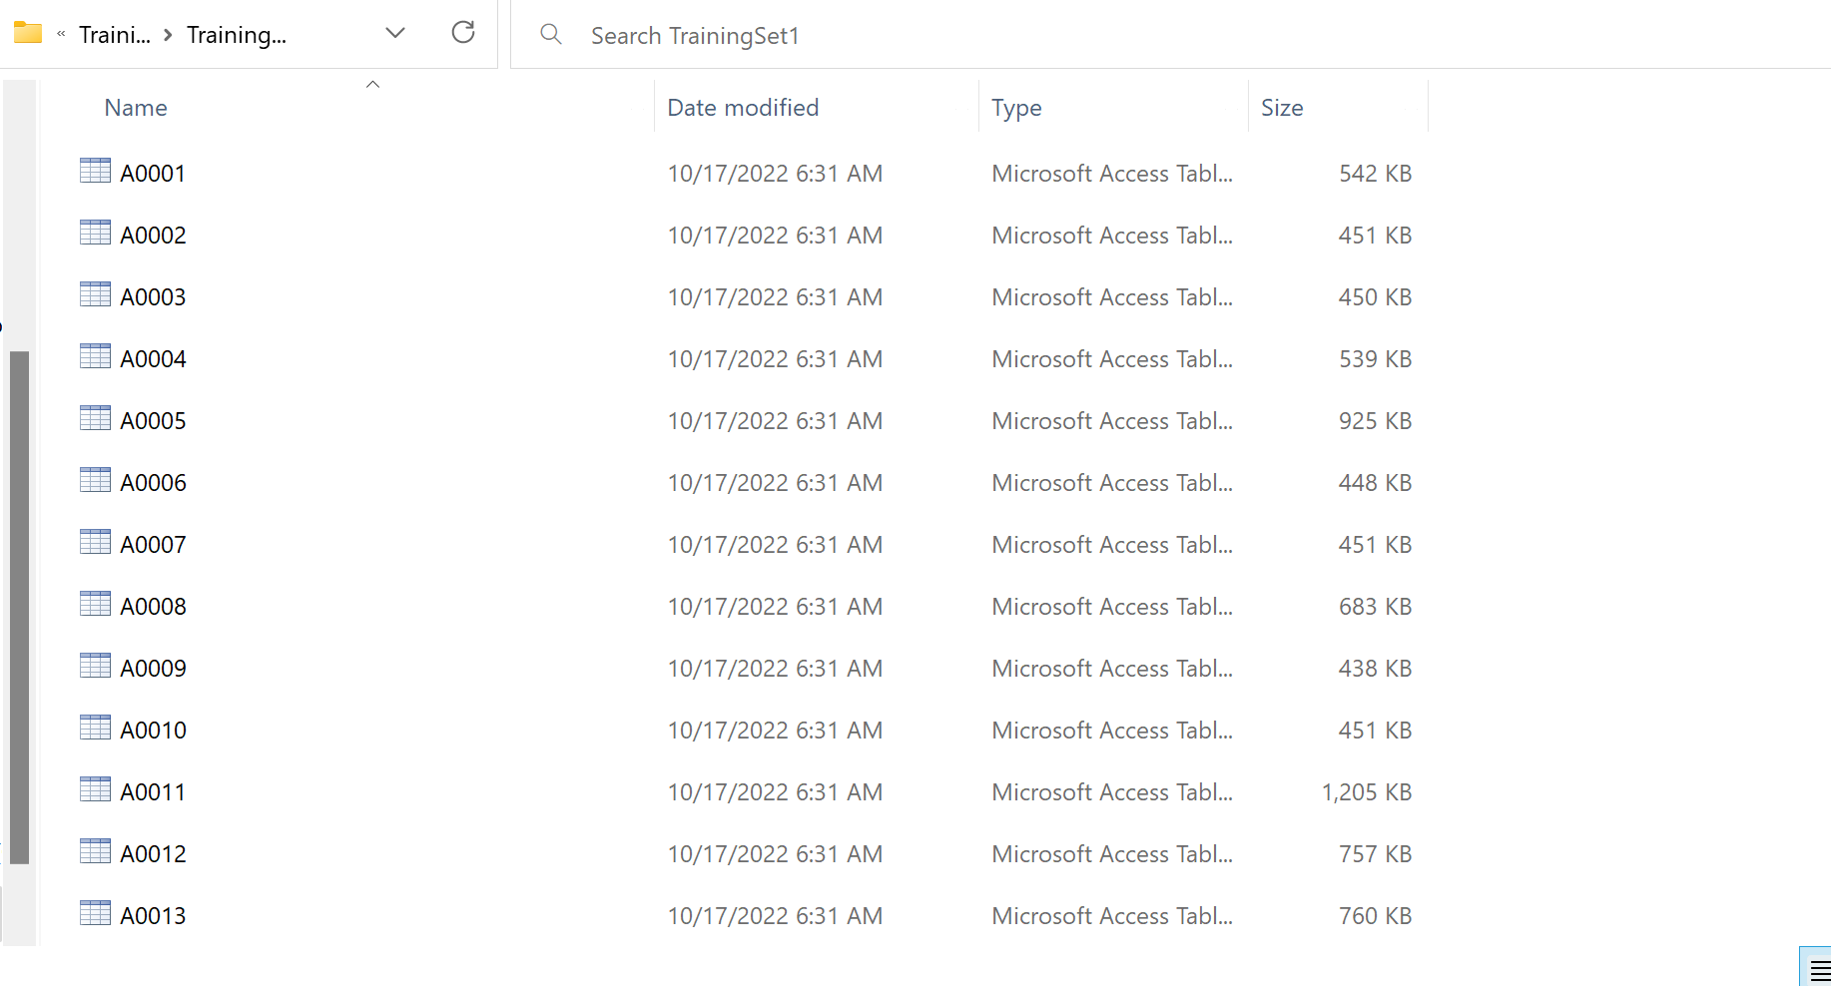
DATASET
6877
12-LEAD ECG RECORDINGS IN MATLAB FILE
9 LABELS

Slide 7
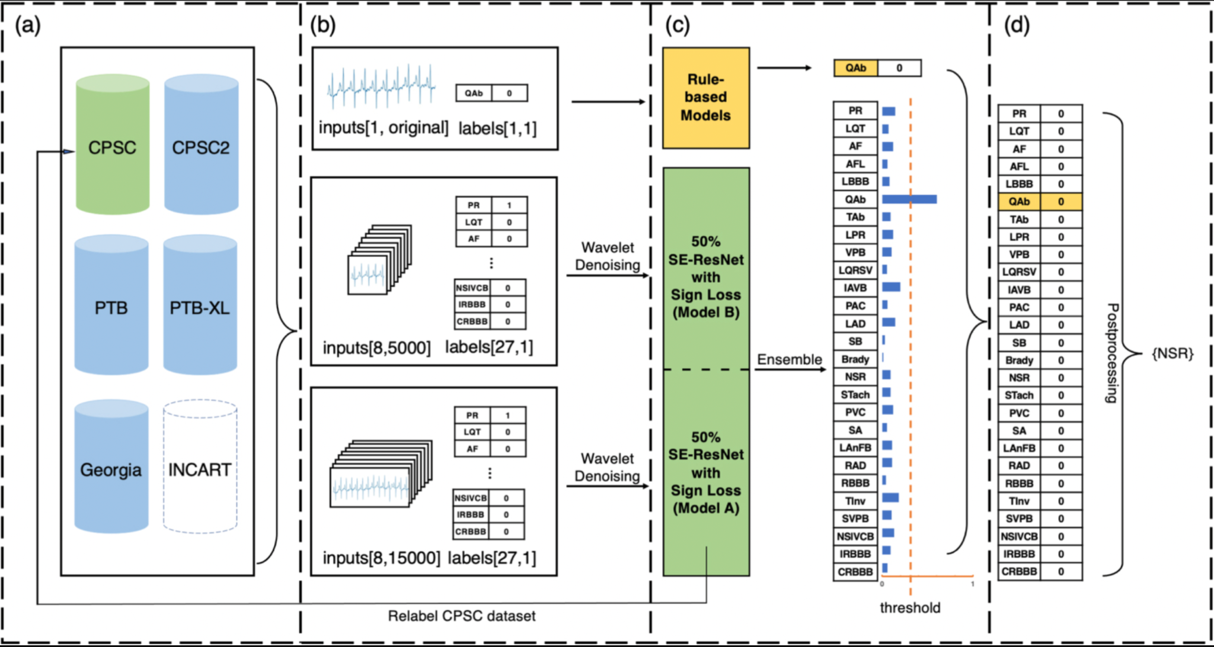
LITERATURE REVIEW
Identification of 27 abnormalities from multi-lead ECG signals: an ensembled SE_ResNet framework with Sign Loss function <2021>
Dataset: 6 different datasets
27 types of abnormalities are identified
Results:
Offline validation score: 0.683

